Slide 1

The Entrepreneur
Module -1

Slide 2

Welcome!!

Slide 3
Introduction
Entrepreneurship in History
Outlines
What is an Entrepreneur?
Myths About Entrepreneurs
Clarifying Goals
Setting Strategy
Executing the Strategy
Why Risk Tolerance is Key to Entrepreneurs’ Success
Assessment
Activity

Slide 4
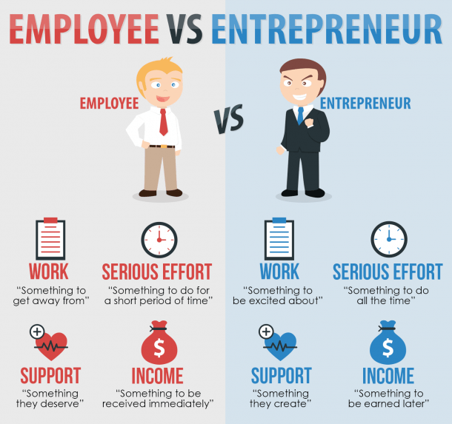

Slide 5
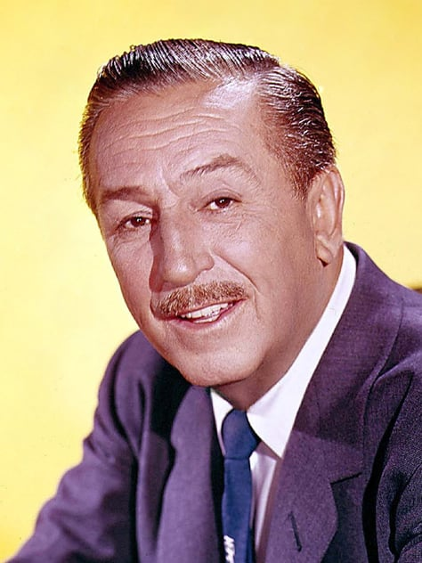
All our dreams can come true,
if we have the courage to pursue them..

Slide 6

Why Be an Entrepreneur?
You may think most people become entrepreneurs to make money. After all, making a good living allows people to provide for their needs and wants instead of depending on others. But more often the biggest reward of becoming an entrepreneur is the feeling of self-sufficiency it brings.

Slide 7
Advantages of being an Entrepreneur
Making Your Own Rules
Creating Greater Wealth
Helping Your Community
Depending on your business, you can decide what type of schedule you work, where you work, and how and when you get paid
A successful business, particularly one that keeps growing, can often be sold for much more than the amount that was invest in it.
Entrepreneurs help others by providing products or services needed by the community.
They also create jobs.
Entrepreneurs often gain personal satisfaction and community recognition from the time and money they donate to worthy causes.

Slide 8
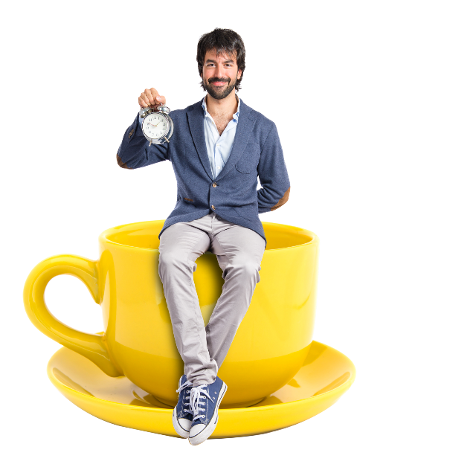
Entrepreneurship in History
Entrepreneurship (on-trah-prih-NER-ship), the process of being an entrepreneur, is more than just learning how to run a business. It can affect the economy, your community, and ultimately the world in which we live.

Slide 9
Examples of entrepreneurs who have changed the world in one way or another

Slide 10
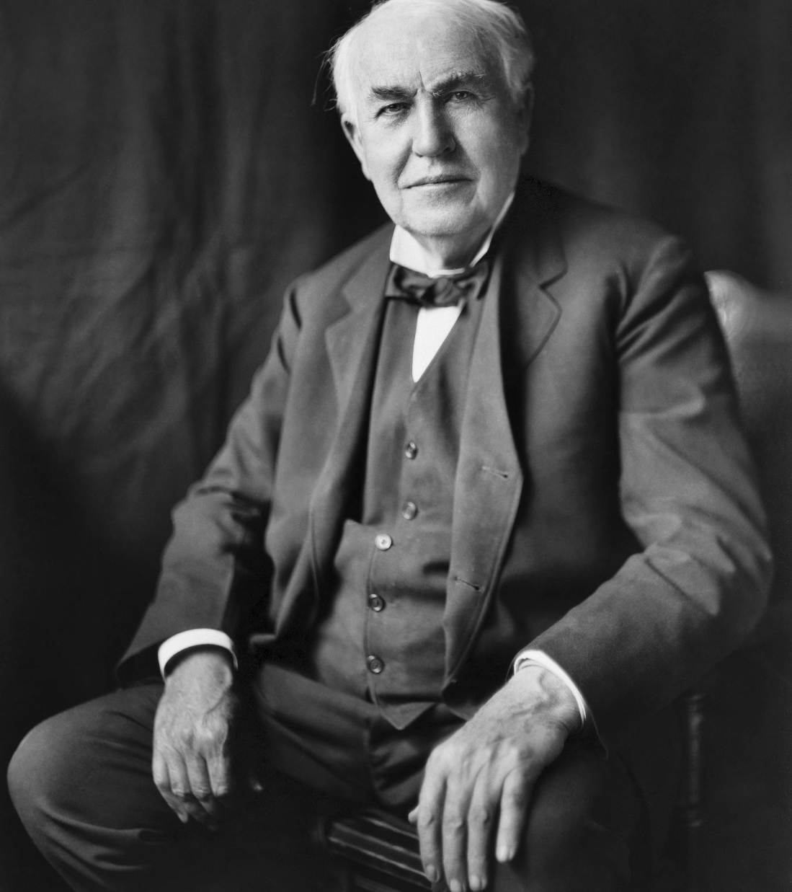
The 1800s
He was selling newspapers, candy, and snacks at the local railroad station. By 14 he had his own newspaper business. Gathering the daily news releases that were teletyped into the station, he pulled out the “scoops” and convinced over 300 commuters to subscribe to his paper, which he called the Weekly Herald. One of the most prolific inventors in history and holding over 1000 patents, Edison is credited with numerous inventions that contributed to mass communication. One of his inventions was the phonograph. Edison’s greatest achievement, however, was creating a practical and economical system to generate and distribute electric light, heat, and power.
Thomas Edison

Slide 11
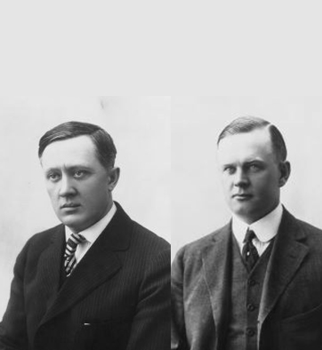
The 1900s
Harley-Davidson was one of only two manufacturers to stay afloat during the Depression of the 1930s. Now it has out ridden its competition to become the world’s largest manufacturer of motorcycles, with revenues of over $41 million annually.
Two friends—William Harley and Arthur Davidson

Slide 12
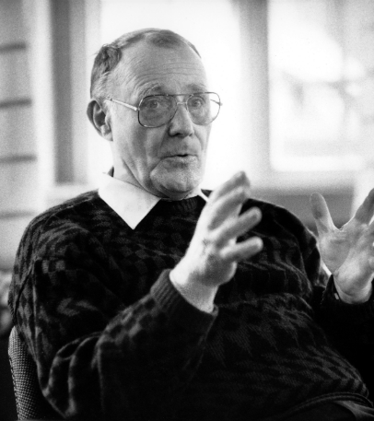
Present - IKEA
When Kamprad was 17, he founded IKEA, a furniture business. Today, IKEA has expanded to 300 stores in over 35 countries and Ingvar Kamprad has become one of the ten wealthiest people in the world.
Ingvar Kamprad

Slide 13

Today’s Entrepreneurs
As in the past, present-day entrepreneurs pay attention to social trends to attract customers. To be successful in today’s business world, most entrepreneurs use the Internet in some way. In fact, more and more companies are making the Internet their primary business resource.
Amazon.com is a good example, doing its business entirely on the Internet.

Slide 14
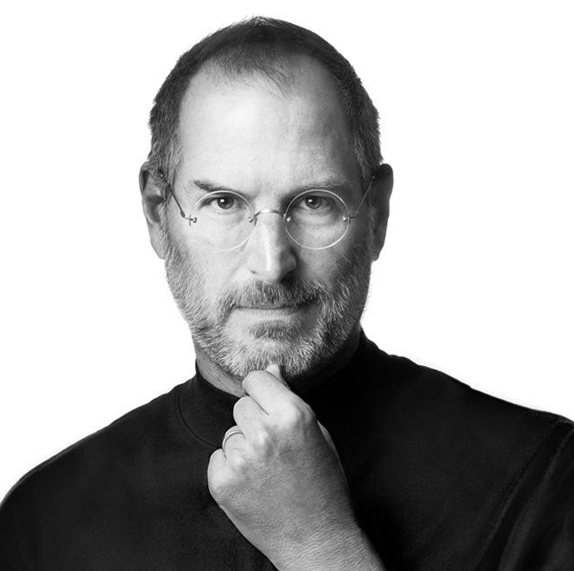
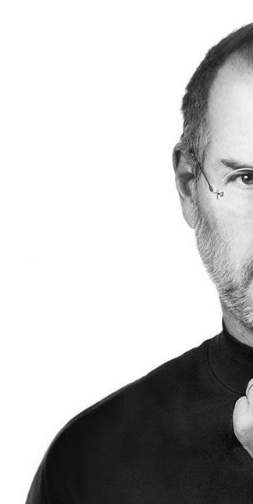
Steve Jobs
What's important is that you have a faith in people, that they're basically good and smart, and if you give them tools,
they'll do wonderful things with them.

Slide 15

An entrepreneur takes an idea, develops a business around it, manages the
business, and assumes the risk for its success.
What is an
Entrepreneur?

Slide 16

Types of Entrepreneurs
Small
business
Home
Based
Business
Online
Business
Inventors
Serial
Entrepreneur
Lifestyle
Entrepreneur

Slide 17
 | 1. Small business
 | This includes mom and pop shops and local business owners. Small business can include partnerships, sole proprietors, and LLCs. Generally it's any business that has less than 500 employees, according to the Small Business Administration.
 | 2. Home-Based Business
 | the primary factor in this case is that it's run from home, as opposed to an office or other location. But just because a business is run from home, doesn't mean it can't compete with larger businesses. In fact, many large corporations were started from a home, including Apple and Disney.

Slide 18
 | 3. Online Business
 | The key difference here is that the business is operated primarily online. This includes companies like Amazon or other e-commerce businesses, bloggers, Ebay etc..
 | 4. Inventors
 | For an inventor to be considered an entrepreneur, he needs to go beyond the idea stage to build the product and get it to market. A good example of inventors that transition to entrepreneurs are the contestants on Shark Tank.

Slide 19
 | 5. Serial Entrepreneur
 | Many entrepreneurs get the most joy out of starting and building a business, but not in its continued management, so they sell it to launch a new idea. They are still considered entrepreneurs because they operate and assume risk in the business for the time they own it. Other times, serial entrepreneurs juggle several businesses at once, earning multiple streams of income.
 | 6. Lifestyle Entrepreneur
 | A lifestyle entrepreneur is one that builds a business that incorporates their interests and passions, and sustains their life goals.

Slide 20
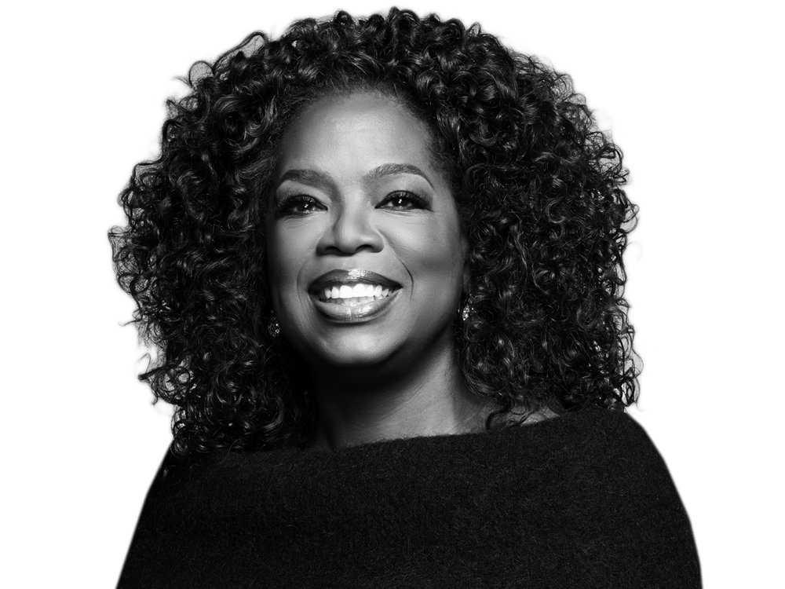
Create the highest,
grandest vision possible
for your life, because
you become what you
believe

Slide 21
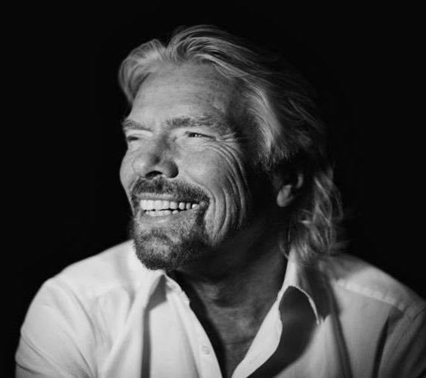
Successful entrepreneurs don't wait for the perfect
moment - they create it
Richard Branson
Characteristics of
a Successful Entrepreneur

Slide 22
Vision
It helps to know your end goal when you start. Further, vision is the fuel that propels you forward toward your goal.
Tenacity
Following your passion is one of the best predictors of success.
Passion
Following your passion is one of the best predictors of success.
Self-confidence
They believe they can achieve their goal.
Independent thinking
Often think outside the box and aren't swayed by others who might question their ideas.
Resourceful and problem solvers
They never let problems and challenges get in the way, and instead find ways to achieve success .
.
Optimism
Entrepreneurs are dreamers and believe their ideas are possible, even when they seem unattainable.
Focus
Successful entrepreneurs are focused on what will bring results.
Action oriented
They overcome challenges and avoid procrastination.

Slide 23
How to Become an Entrepreneur
One of the great things about becoming an entrepreneur is that anyone can do it.
1
2
Becoming an entrepreneur isn't hard, but it is work and requires many steps
including:
Development of the characteristics of a Successful Entrepreneur
“mentioned in the previous slides”
A great idea that people will pay
money for
4
3
A plan of success
Consistent execution of the plan

Slide 24

10 Biggest Myths About Being
An Entrepreneur

Slide 25
1
Entrepreneurs Are High Risk Takers
They seldom act until they have assessed all the risks associated with an endeavor, and they have an innate ability to make sense out of complexity. These are traits that carry them on to success where others fail.

Slide 26
2
Entrepreneurs Are Born
Experts generally agree that most entrepreneurs were not born; they learned to become entrepreneurs

Slide 27
3
Entrepreneurs Are Mainly Motivated to Get Rich
New businesses usually take from one to three years to turn a profit. In the meantime, you’re considered to be doing well if you break even. During the business start-up stage, entrepreneurs do not buy anything they do not need, such as fancy cars. Most drive junk cars and use their surplus money to pay off debt or reinvest it in the business. Their focus is on creating a company with a strong financial base for future expansion.

Slide 28
4
Entrepreneurs Give Little Attention to
Their Personal
Entrepreneurs are not afraid to work long hours, but they will do everything to preserve their private time and schedule control.

Slide 29
5
Entrepreneurs Are Often High-Tech
Wizards
It takes high profit margins, not high tech, to make it as an entrepreneur. One has only to look at the recent problems that have plagued the computer industry to understand this basic principle. High-tech personal computers did very well when they made high profit margins. The industry then went into a nosedive when profits fell.

Slide 30
6
Entrepreneurs Are Loners and
Introverts
Entrepreneurs need to seek the advice of others. A loner will find it difficult to start a successful business.

Slide 31
7
Entrepreneurs Are Job Hoppers
Most of them worked for a large corporation for a number of years before they started their own business. In every instance, they used the corporate structure to learn everything they could about the business they intended to establish before they started their own. Entrepreneurs are not job hoppers.

Slide 32
8
Entrepreneurs Finance Their Business with Venture
Capital
Venture capital money is one of the most expensive forms of funding they can get. Consequently, they will avoid venture capitalists, using them only as a last resort. Most entrepreneurs fund their business from personal savings, or by borrowing from friends or lending institutions.

Slide 33
9
Entrepreneurs Are Often Ruthless or
Deceptive
Some people believe that to make it as an entrepreneur, you have to be deceptive and step on anybody who gets in your way. On the contrary, this mode of operation doesn’t work for the entrepreneur. The truly ruthless or deceptive entrepreneur will often alienate others and be forced to waste time and energy repairing relationships with employees, customers, and suppliers, or simply fail.

Slide 34
10
Entrepreneurs
Have Limited
Dedication
Entrepreneurs are not dedicated to any one thing. But he adds that dedication is an attribute that all successful entrepreneurs exhibit. They are dedicated to becoming their own boss. To this end, they’ll work like a dog to make their business succeed.

Slide 35
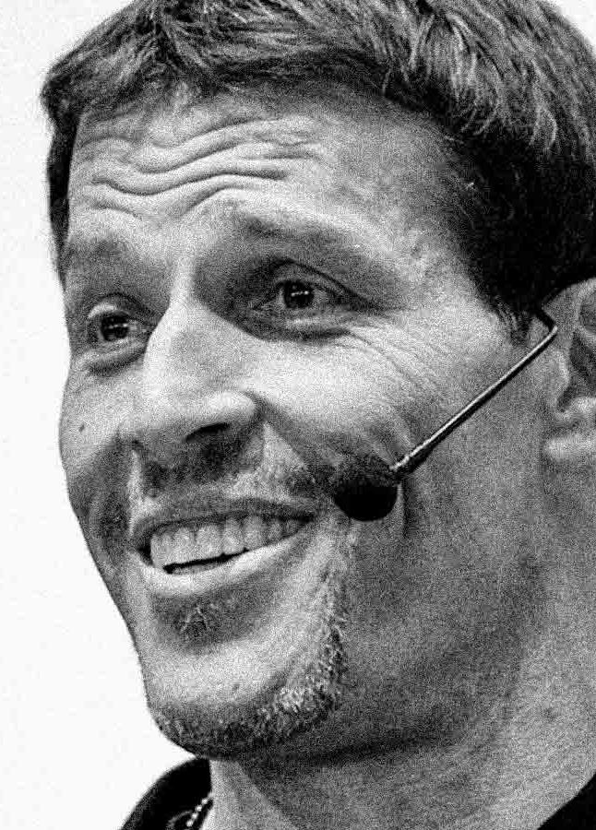
Tony Robbins
“Setting goals is
the first step in
turning the invisible into the visible.”

Slide 36

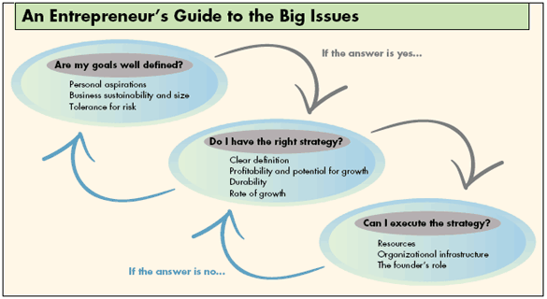
Clarifying Goals: Where Do I Want to Go?
Before they can set goals for a business, entrepreneurs must be explicit about their personal goals. And they must periodically ask themselves if those goals have changed. Many entrepreneurs say that they are launching their businesses to achieve independence and control their destiny, but those goals are too vague. If they stop and think about it, most entrepreneurs can identify goals that are more specific.

Slide 37

- What kind of enterprise do I need to build?
- What risks and sacrifices does such an enterprise demand?
- Can I accept those risks and sacrifices?
?
Only when entrepreneurs can say what they want personally from their businesses does it make sense for them to ask the following three questions:

Slide 38

What kind of enterprise do I need to build?
Entrepreneurs’ personal goals should determine the target size of the businesses they launch. A lifestyle entrepreneur’s venture needn’t grow very large. In fact, a business that becomes too big might prevent the founder from enjoying life or remaining personally involved in all aspects of the work. In contrast, entrepreneurs seeking capital gains must build companies large enough to support an infrastructure that will not require their day-to-day intervention.

Slide 39
What risks and sacrifices does such an enterprise demand?
Entrepreneurs who operate small-scale, or lifestyle, ventures face different risks and stresses. Talented people usually avoid companies that offer no stock options and only limited opportunities for personal growth, so the entrepreneur’s long hours may never end. Because personal franchises are difficult to sell and often require the owner’s daily presence, founders may become locked into their businesses. They may face financial distress if they become sick or just burn out. “I’m always running, running, running,” complains one entrepreneur, whose business earns him half a million dollars per year. “I work 14-hour days, and I can’t remember the last time I took a vacation. I would like to sell the business, but who wants to buy a company with no infrastructure or employees?”

Slide 40
Can I accept those risks and sacrifices?
Entrepreneurs would do well to follow Alsop’s example by thinking explicitly about what they are and are not willing to risk. If entrepreneurs find that their businesses even if very successful—won’t satisfy them personally, or if they discover that achieving their personal goals requires them to take more risks and make more sacrifices than they are willing to, they need to reset their goals. When entrepreneurs have aligned their personal and their business goals, they must then make sure that they have the right strategy.

Slide 41

Entrepreneurs’ personal goals should determine the target size of the businesses they launch. A lifestyle entrepreneur’s venture needn’t grow very large. In fact, a business that becomes too big might prevent the founder from enjoying life or remaining personally involved in all aspects of the work. In contrast, entrepreneurs seeking capital gains must build companies large enough to support an infrastructure that will not require their day-to-day intervention.
What kind
of Enterprise
do I need to
build?

Slide 42

What risks and sacrifices does such an enterprise demand?
Entrepreneurs who operate small-scale, or lifestyle, ventures face different risks and stresses. Talented people usually avoid companies that offer no stock options and only limited opportunities for personal growth, so the entrepreneur’s long hours may never end. Because personal franchises are difficult to sell and often require the owner’s daily presence, founders may become locked into their businesses. They may face financial distress if they become sick or just burn out. “I’m always running, running, running,” complains one entrepreneur, whose business earns him half a million dollars per year. “I work 14-hour days, and I can’t remember the last time I took a vacation. I would like to sell the business, but who wants to buy a company with no infrastructure or employees?”

Slide 43

Can I accept those risks and sacrifices?
Entrepreneurs would do well to follow Alsop’s example by thinking explicitly about what they are and are not willing to risk. If entrepreneurs find that their businesses—even if very successful—won’t satisfy them personally, or if they discover that achieving their personal goals requires them to take more risks and make more sacrifices than they are willing to, they need to reset their goals. When entrepreneurs have aligned their personal and their business goals, they must then make sure that they have the right strategy.

Slide 44
Setting Strategy: How Will I Get There?
Many entrepreneurs start businesses to seize short-term opportunities without thinking about long-term strategy.
Entrepreneurs should periodically put their strategies to the following four tests:
Is the strategy well defined?
Can the strategy generate sufficient profits and growth?
Is the strategy sustainable?
Are my goals for growth too conservative or too aggressive?

Slide 45

Is the strategy well defined?
An entrepreneur who wants to build a sustainable company must formulate a bolder and more explicit strategy. The strategy should integrate the entrepreneur’s aspirations with specific long-term policies about the needs the company will serve, its geographic reach, its technological capabilities, and other strategic considerations. To help attract people and resources, the strategy must embody the entrepreneur’s vision of where the company is going instead of where it is. The strategy must also provide a framework for making the decisions and setting the policies that will take the company there

Slide 46

Can the strategy generate
sufficient profits and growth?
When a new venture is faltering, entrepreneurs must address basic economic issues. For instance, many people are attracted to personal service businesses, such as laundries and tax-preparation services, because they can start and operate those businesses just by working hard. They don’t have to worry about confronting large competitors, raising a lot of capital, or developing proprietary technology. But the factors that make it easy for entrepreneurs to launch such businesses often prevent them from attaining their long-term goals. Businesses based on an entrepreneur’s willingness to work hard usually confront other equally determined competitors

Slide 47

Is the strategy sustainable?
They must build on their initial strength by developing multiple strengths. Brand-new ventures usually cannot afford to innovate on every front. Few start-ups, for example, can expect to attract the resources needed to market a revolutionary product that requires radical advances in technology, a new manufacturing process, and new distribution channels.

Slide 48

Are my goals for growth too conservative or too aggressive?
Entrepreneur should determine whether plans for its growth are appropriate. Different enterprises can and should grow at different rates. Setting the right pace is as important to a young business as it is to a novice bicyclist.

Slide 49
Executing the Strategy: Can I Do It?
The third question entrepreneurs must ask themselves may be the hardest to answer because it requires the most candid self-examination: Can I execute the strategy? Great ideas don’t guarantee great performance.
Entrepreneurs must examine three areas—resources, organizational capabilities, and their personal roles—to evaluate their ability to carry out their strategies.
- Do I have the right resources and relationships?
- How strong is the organization?
- Can I play my role?

Slide 50

For a new venture to survive, some resources that initially are external may have to become internal. Many start-ups operate at first as virtual enterprises because the founders cannot afford to produce in-house and hire employees, and because they value flexibility. But the flexibility that comes from owning few resources is a double-edged sword. Just as a young company is free to stop placing orders, suppliers can stop filling them. Furthermore, a company with no assets signals to customers and potential investors that the entrepreneur may not be committed for the long haul. A business with no employees and hard assets may also be difficult to sell, because potential buyers will probably worry that the company will vanish when the founder departs.
Do I have the right resources and relationships?

Slide 51
How strong is the organization?
When entrepreneurs neglect to articulate organizational norms and instead hire employees mainly for their technical skills and credentials, their organizations develop a culture by chance rather than by design. The personalities and values of the first wave of employees shape a culture that may not serve the founders’ goals and strategies. Once a culture is established, it is difficult to change.
When entrepreneurs don’t stop to think about culture, their companies develop one by chance rather than by design.

Slide 52

Can I play my role?
Entrepreneurs who aspire to operate small enterprises in which they perform all crucial tasks never have to change their roles. In personal service companies, for instance, the founding partners often perform client work from the time they start the company until they retire. Transforming a fledgling enterprise into an entity capable of an independent existence, however, requires founders to undertake new roles.

Slide 53
Risk Tolerance is Key to Entrepreneurs’ Success
Starting a business or joining an early-stage start-up means risking your social status, your income, and much of your free time; it means risking years of loneliness and years without proper support. It means putting your energy, your financial standing, your social capital, and often years of your life on the line for a high-risk, high-reward, high-failure path.
If you’re at the early stages of building your own company, you’ve taken that leap, and you know how it goes. If you’re still climbing the diving board, wondering if you’ve got it in you: take a step up to the edge, and take a bet on yourself. Your tolerance for risk might surprise you.

Slide 54
Assessment
Activity
_{Assessment}
Choose an entrepreneur from the past, and describe the risks and rewards involved in starting his or her business. Discuss whether the entrepreneur made life better in some way with a product or service.
Why do you think an entrepreneur might choose to keep a business small rather than expand it?
List several personal characteristics that might hinder someone from becoming an entrepreneur. In what ways could these characteristics also prevent someone from becoming a valued employee?
Develop a vision and mission for your life now, as a student. Then develop a vision and mission for your future life. Keep these simple.
How do entrepreneurs and employees differ?
What are four rewards and fo ur risks of being an entrepreneur?
Name three successful entrepreneurs and describe what they achieved.

